Slide 1
MANAGEMENT OF TYPE 2 DIABETES: RECENT UPDATES
Prof. Quazi Tarikul Islam
Professor of Medicine
Popular Medical College & Hospital
Dhanmondi, Dhaka

Slide 2
Standards of Medical Care in Diabetes—2014
Notes:
“Standards of Medical Care in Diabetes—2014” comprises all of the current and key clinical practice recommendations of the American Diabetes Association (ADA)
These Standards of Care are revised annually by the ADA’s multidisciplinary Professional Practice Committee (PPC)
For the current revision, PPC members systematically searched Medline for human studies related to each subsection and published since 1 January 2013
Recommendations were revised based on new evidence or, in some cases, to clarify the prior recommendations or match the strength of the word to the strength of the evident
A table linking the changes in the recommendations to new evidence can be reviewed at http://professional.diabetes.org/CPR
As for all position statements, the Standards of Care were reviewed and approved by the Executive Committee of ADA’s Board of Directors, which includes health care professionals, scientists, and lay people
Feedback from the larger clinical community was valuable for the 2014 revision of the Standards of Care; readers who wish to comment on the “Standards of Medical Care in Diabetes—2014” are invited to do so at http://professional.diabetes.org/CPR
ADA funds development of the Standards of Care and all ADA position statements out of its general revenues and does not use industry support for these purposes
The slides are organized to correspond with sections within the “Standards of Medical Care in Diabetes—2014”
While not every section in the document is represented, these slides do incorporate the most salient points from the Position Statement
Reference
American Diabetes Association. Standards of medical care in diabetes—2014. Diabetes Care 2014;37(suppl 1):S1

Slide 3
Global situation of Diabetes Mellitus
The number of people with type 2 diabetes around the world is estimated to rise from 151 million in 2000 to 300 million by 2025. The recognition that strict glycaemic control can reduce microvascular complications has made the effective treatment of hyperglycaemia a priority.
Ref. BMJ Vol333 Dec 9, 2006
US Focus-it strikes 16 million Americans
ARE YOU AT RISK?

Slide 4
Contents
Global Prevalence of Diabetes
Management of Type 2 Diabetes
Glycemic recommendations
Anti-hyperglycemic therapy
Diabetic Complications
Prevention & management of complications

Slide 5
Global Prevalence of Diabetes

Slide 6
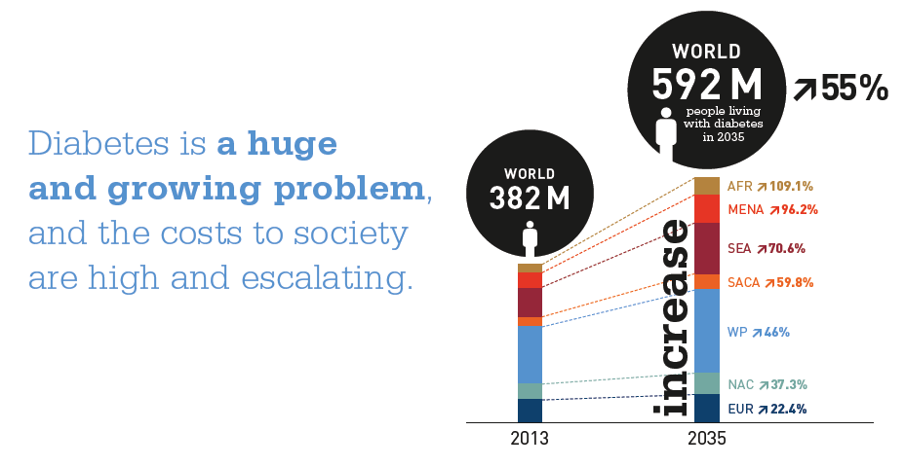
High prevalence of Diabetes
IDF Diabetes Atlas I Sixth edition

Slide 7
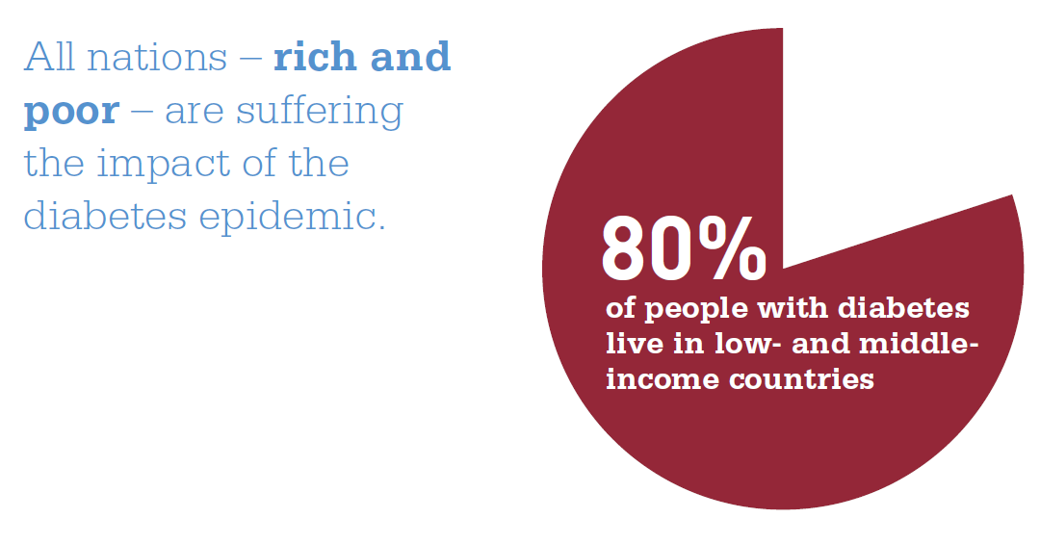
Diabetes: the global burden
IDF Diabetes Atlas I Sixth edition

Slide 8
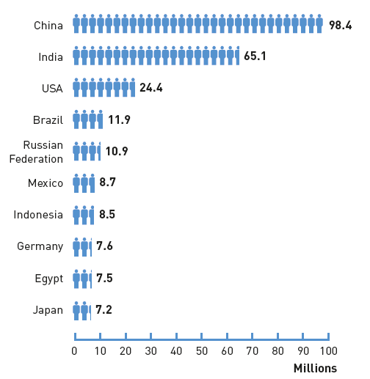
Top 10 countries of diabetes (20-79 years), 2013
IDF Diabetes Atlas I Sixth edition

Slide 9
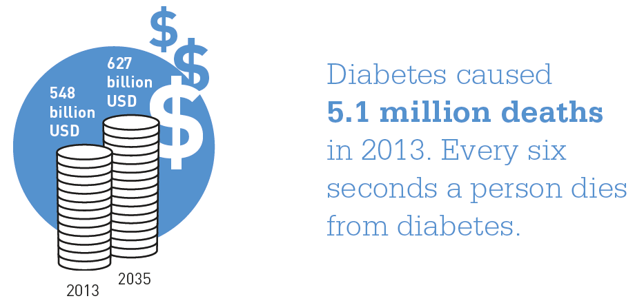
Global health expenditure due to diabetes (20-79 years)
IDF Diabetes Atlas I Sixth edition

Slide 10
List of Countries with the highest numbers of estimated cases of diabetes for 2000 and 2030
Ref. Diabetes Care Volume 27 Number 05 May 2004

Slide 11
Understanding Diabetes

Slide 12
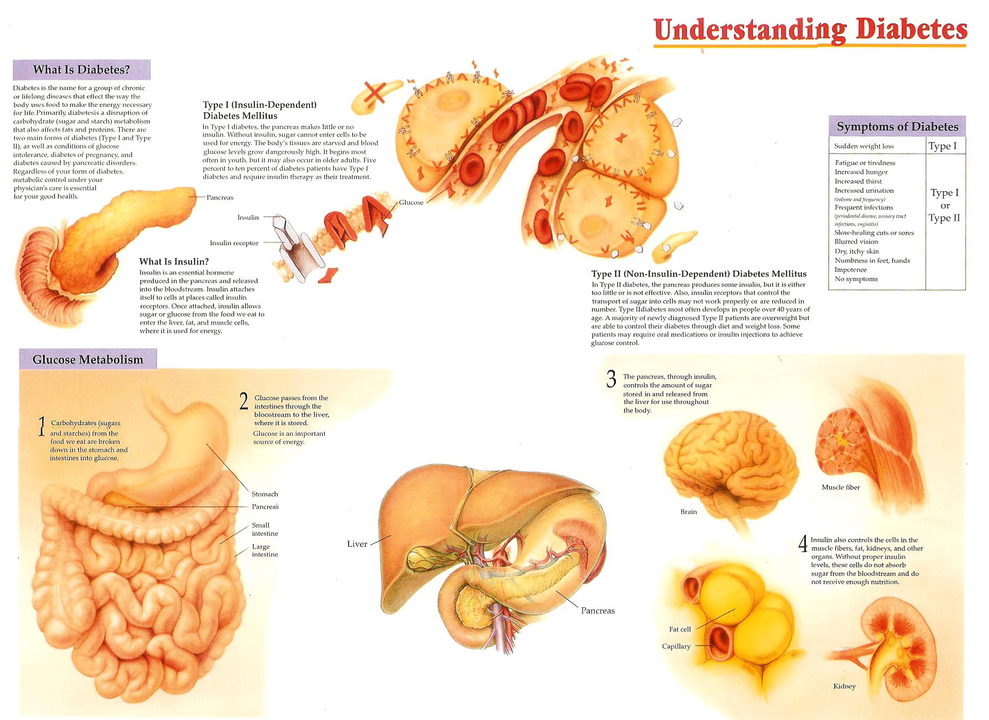

Slide 13
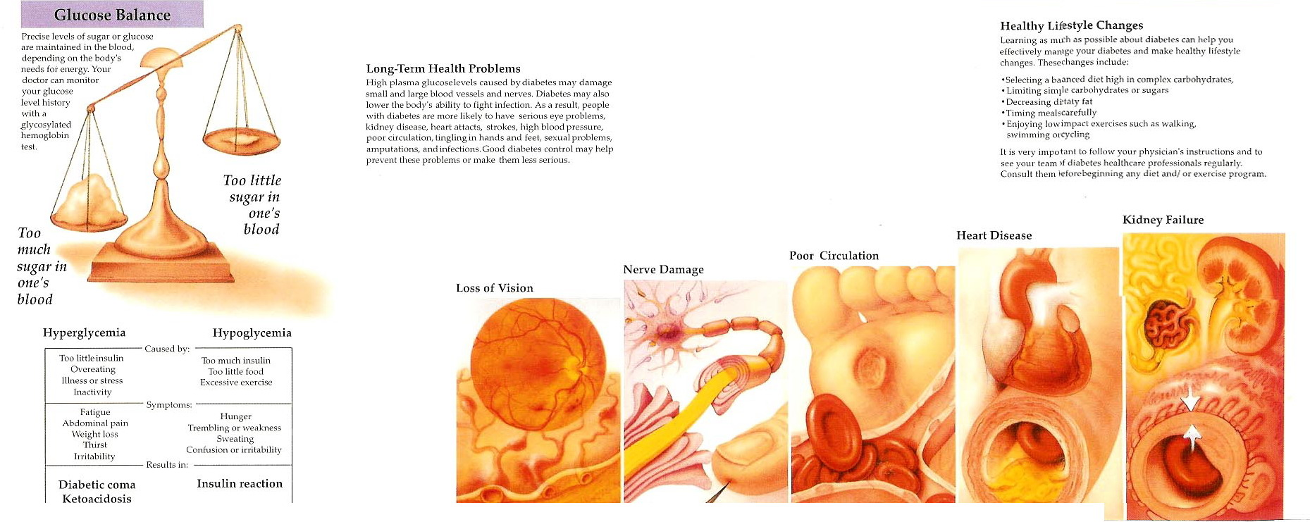

Slide 15
Type 2 Diabetes: A Dual Defect Disease
Genes
Genes
Impaired Insulin
Secretion
Insulin
Resistance
± Environment
IGT
IGT
Type 2 Diabetes
IGT = Impaired Glucose Tolerance
Notes:
Developed by Derek Le Roith, M.D., Ph.D.
Aventis Dinner 2000
Slide 3
Type 2 Diabetes:
Two Defects
The pathophysiology of type 2 diabetes mellitus is related to two defects. The clinical expression of this disease usually requires the presence of both impaired insulin secretion and insulin resistance. These traits are thought to be genetically determined although the genes have not yet been identified. Environmental factors, such as obesity, a high-fat diet, physical inactivity, or some medications, usually participate in the expression of these traits. Individuals with one genetic defect, with or without an environmental trigger, may demonstrate impaired glucose tolerance or impaired fasting glucose but do not typically develop frank diabetes. In most instances, both β-cell dysfunction and insulin resistance are required for the development of the hyperglycemia of type 2 diabetes.

Slide 16
Course of Type 2 Diabetes
Obesity
IFG*
Diabetes
Uncontrolled Hyperglycemia
350 –
300 –
Postmeal Glucose
Glucose
(mg/dL)
250 –
200 –
Fasting Glucose
150 –
100 –
50 –
250 –
Relative Function (%)
200 –
Insulin Resistance
150 –
100 –
50 –
β-cell Failure
0 –
-10
-5
0
5
10
15
20
25
30
Years of Diabetes
Notes:
16

Slide 17
Progressive Nature of Type 2 Diabetes
IGT
Diabetes
Endogenous Insulin
Normal
Insulin Resistance
Postprandial Blood Glucose
Normal Blood Glucose
Fasting Blood Glucose
Avg Dx
9-12 yrs*
Years
Notes:
Treatment decisions are based on how well the pancreas is working to produce insulin. An A1C test will provide this information but often the diagnosis is made too late to; health care professionals should screen early in order to begin intervention early.
Insulin resistance (characterized by impaired glucose tolerance) begins years before type 2 diabetes. This is linked to macrovascular disease.
In response, beta cell function accelerates to compensate for the increased insulin resistance.
In response to deteriorating beta cell function and subsequent loss of first-phase insulin response, postprandial glucose was the first glycemic abnormality, which is associated with the initiation of macrovascular complications.
Fasting glucose levels remain normal during the initial stages of this cycle and then eventually rise above 126 mg/dL. This is clinical diabetes, characterized by continued insulin resistance, insulin deficiency and relentless beta cell deterioration.
Average diagnosis, however, occurs 9-12 years after clinical diabetes is manifested. Given the high prevalence of microvascular complications among Latinos and African Americans (as was shown earlier in slide #4), it is reasonable to suspect that diabetes is diagnosed even later in these high-risk populations.
Because beta cell deterioration is unrelenting, all patients will require progressively more aggressive therapeutic interventions.
With the increasing prevalence of type 2 diabetes among younger adults, we will see many more patients living longer with diabetes.

Slide 18
Progression to Type 2 Diabetes
Genetic Factors
Acquired:
Obesity
Sedentary lifestyle
Aging
Insulin resistance
Hyperinsulinemia
Compensated insulin resistance
Normal glucose tolerance
ß-cell decompensation
Impaired glucose tolerance
Genetic Factors
Glucose and/or
fat toxicity
ß-cell “failure”
Type 2 diabetes
Ref. Kruszynska Y, Olefsky JM. J Invest Med.
1996;44:413-428.
Weyer C, et al. J Clin Invest. 1999;104:787-794.
Notes:
This slide illustrates the pathophysiologic progression from an at-risk state to full expression of diabetes. While this scheme is not agreed on by all experts, there is general consensus.
Early in the course, a characteristic finding is insulin resistance. Insulin resistance is thought to be influenced by genetic and perhaps congenital factors, and is certainly influenced by acquired or environmental factors, such as obesity, sedentary lifestyle, and aging.
Under normal circumstances and with normal beta-cell function, hyperinsulinemia compensates for the insulin resistance and maintains normal glucose tolerance.
Early beta-cell decompensation manifests as impaired glucose tolerance—a state of impaired glucose handling.
As disease progresses, beta cells fail to function adequately and hepatic glucose production increases, subsequently leading to an increase in fasting plasma glucose and the development of frank type 2 diabetes.
Beta-cell failure may be due to genetic and environmental factors, prevailing hyperglycemia, and elevated free fatty acids (glucose and/or fat toxicity).

Slide 19
Glycemic recommendations of Type 2 Diabetes

Slide 20
Recommendations: Glycemic Goals in Adults (1)
Lowering A1C to below or around 7% has been shown to reduce micro-vascular complications and, if implemented soon after the diagnosis of diabetes, is associated with long-term reduction in macro-vascular disease
Therefore, a reasonable A1C goal for many non-pregnant adults is <7%
ADA. V. Diabetes Care. Diabetes Care 2014;37(suppl 1):S23

Slide 21
Recommendations: Glycemic Goals in Adults (2)
Providers might reasonably suggest more stringent A1C goals (such as <6.5%) for selected individual patients, if this can be achieved without significant hypoglycemia or other adverse effects of treatment
Appropriate patients might include those with short duration of diabetes, long life expectancy, and no significant CVD
ADA. V. Diabetes Care. Diabetes Care 2014;37(suppl 1):S23

Slide 22
Recommendations: Glycemic Goals in Adults (3)
Less stringent A1C goals (such as <8%) may be appropriate for patients with
- History of severe hypoglycemia, limited life expectancy, advanced microvascular or macrovascular complications, extensive comorbid conditions
- Those with longstanding diabetes in whom the general goal is difficult to attain despite DSME, appropriate glucose monitoring, and effective doses of multiple glucose lowering agents including insulin
ADA. V. Diabetes Care. Diabetes Care 2014;37(suppl 1):S23

Slide 23
Approach to Management of Hyperglycemia
ADA. V. Diabetes Care. Diabetes Care 2014;37(suppl 1):S25. Figure 1; adapted with permission from Ismail-Beigi F, et al. Ann Intern Med 2011;154:554-559

Slide 24
Glycemic Recommendations for Non-pregnant Adults (1)
A1C | <7.0%*
Preprandial capillary plasma glucose | 70–130 mg/dL* (3.9–7.2 mmol/L)
Peak postprandial capillary plasma glucose† | <180 mg/dL* (<10.0 mmol/L)
*Goals should be individualized based on these values.
†Postprandial glucose measurements should be made 1–2 h after the beginning of the meal, generally peak levels in patients with diabetes.
ADA. V. Diabetes Care. Diabetes Care 2014;37(suppl 1):S26; Table 9

Slide 25
Glycemic Recommendations for Non-pregnant Adults (2)
Goals should be individualized based on
Duration of diabetes
Age/life expectancy
Co-morbid conditions
Known CVD or advanced micro-vascular complications
Hypoglycemia unawareness
Individual patient considerations
ADA. V. Diabetes Care. Diabetes Care 2014;37(suppl 1):S26; Table 9

Slide 26
Glycemic Recommendations for Non-pregnant Adults (3)
More or less stringent glycemic goals may be appropriate for individual patients
Postprandial glucose may be targeted if A1C goals are not met despite reaching preprandial glucose goals
ADA. V. Diabetes Care. Diabetes Care 2014;37(suppl 1):S27

Slide 27
Management of Type 2 Diabetes

Slide 28
3 ‘D’ for Management
Dietary readjustment
Discipline and life style modification
Drug treatment that includes
- OHD
- Insulin

Slide 29
Methods:
 Diet- 50%
 Diet+ Oral Hypoglycemic drug- 20-30%
 Diet + Insulin + OHD – 20-30%

Slide 30
Control of DM by dietary measure by taking of-
(a) Restricted refined carb diet- Sugar, Sweet.
(b) Measured diet-
-CHO - 60%
- Protein- 20%
- Fat- 20%

Slide 31
Daily Energy intake (In calories) Should be
 30 Kcal/KGBW/Day- Mild worker
 35 Kcal/KGBW/Day- Moderate worker
 40 Kcal/KGBW/Day- Hard worker

Slide 33
When to start Insulin
Obesity
IFG*
Diabetes
Uncontrolled Hyperglycemia
350 –
300 –
Postmeal Glucose
Glucose
(mg/dL)
250 –
200 –
Fasting Glucose
150 –
100 –
50 –
250 –
Relative Function (%)
200 –
Insulin Resistance
150 –
100 –
50 –
β-cell Failure
0 –
-10
-5
0
5
10
15
20
25
30
Years of Diabetes

Slide 34
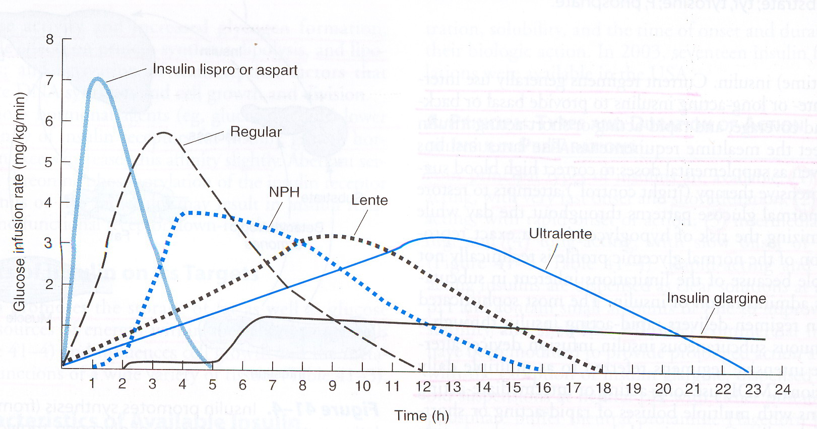

Slide 35
Side effect:
Hypoglycemia
Weight gain
Peripheral edema ( Insulin Rx cause salt & water retention in short term)
Local allergy
Lipo-dystrophy at injection sites
Calculation of amount of insulin required
RBS in mg/dl
Units insulin required
=
30

Slide 36
Combination oral hypoglycaemic drug & insulin:
Pts. requiring increasing doses of a sulphonylureas or biguanide either alone or in combination with each other or a thiozolidinediones the introduction of a single dose of an intermediate acting insulin administered at bed time

Slide 37
Recommendations: Therapy for Type 2 Diabetes (1)
Metformin, if not contraindicated and if tolerated, is the preferred initial pharmacological agent for type 2 diabetes
In newly diagnosed type 2 diabetic patients with markedly symptomatic and/or elevated blood glucose levels or A1C, consider insulin therapy, with or without additional agents, from the outset
ADA. V. Diabetes Care. Diabetes Care 2014;37(suppl 1):S27

Slide 38
Recommendations: Therapy for Type 2 Diabetes (2)
If noninsulin monotherapy at maximal tolerated dose does not achieve or maintain the A1C target over 3 months, add a second oral agent, a GLP-1 receptor agonist, or insulin
ADA. V. Diabetes Care. Diabetes Care 2014;37(suppl 1):S27

Slide 39
Recommendations: Therapy for Type 2 Diabetes (3)
A patient-centered approach should be used to guide choice of pharmacological agents
Considerations include efficacy, cost, potential side effects, effects on weight, comorbidities, hypoglycemia risk, and patient preferences E
Due to the progressive nature of type 2 diabetes, insulin therapy is eventually indicated for many patients with type 2 diabetes
ADA. V. Diabetes Care. Diabetes Care 2014;37(suppl 1):S27

Slide 40
Antihyperglycemic Therapy in Type 2 Diabetes
ADA. V. Diabetes Care. Diabetes Care 2014;37(suppl 1):S27. Figure 2; adapted with permission from Inzucchi SE, et al. Diabetes Care 2012;35:1364–1369

Slide 41
Antihyperglycemic Therapy in Type 2 Diabetes
ADA. V. Diabetes Care. Diabetes Care 2014;37(suppl 1):S27. Figure 2; adapted with permission from Inzucchi SE, et al. Diabetes Care 2012;35:1364–1369

Slide 42
Antihyperglycemic Therapy in Type 2 Diabetes
ADA. V. Diabetes Care. Diabetes Care 2014;37(suppl 1):S27. Figure 2; adapted with permission from Inzucchi SE, et al. Diabetes Care 2012;35:1364–1369

Slide 43
Antihyperglycemic Therapy in Type 2 Diabetes
ADA. V. Diabetes Care. Diabetes Care 2014;37(suppl 1):S27. Figure 2; adapted with permission from Inzucchi SE, et al. Diabetes Care 2012;35:1364–1369

Slide 44
Antihyperglycemic Therapy in Type 2 Diabetes
ADA. V. Diabetes Care. Diabetes Care 2014;37(suppl 1):S27. Figure 2; adapted with permission from Inzucchi SE, et al. Diabetes Care 2012;35:1364–1369

Slide 45
Recommendations: Physical Activity
Children with diabetes/prediabetes: engage in at least 60 min/day physical activity
Adults with diabetes: at least 150 min/wk of moderate-intensity aerobic activity (50–70% of maximum heart rate), over at least 3 days/wk with no more than 2 consecutive days without exercise
If not contraindicated, adults with type 2 diabetes should perform resistance training at least twice weekly
ADA. V. Diabetes Care. Diabetes Care 2014;37(suppl 1):S31

Slide 46
Recommendations: Hypoglycemia (1)
Individuals at risk for hypoglycemia should be asked about symptomatic and asymptomatic hypoglycemia at each encounter
Glucose (15–20 g) preferred treatment for conscious individual with hypoglycemia
Glucagon should be prescribed for all individuals at significant risk of severe hypoglycemia and caregivers/family members instructed in administration
ADA. V. Diabetes Care. Diabetes Care 2014;37(suppl 1):S33

Slide 47
Recommendations: Hypoglycemia (2)
Hypoglycemia unawareness or one or more episodes of severe hypoglycemia should trigger re-evaluation of the treatment regimen
Insulin-treated patients with hypoglycemia unawareness or an episode of severe hypoglycemia
Advised to raise glycemic targets to strictly avoid further hypoglycemia for at least several weeks, to partially reverse hypoglycemia unawareness, and to reduce risk of future episodes
ADA. V. Diabetes Care. Diabetes Care 2014;37(suppl 1):S33

Slide 48
Recommendations: Hypoglycemia (3)
Ongoing assessment of cognitive function is suggested with increased vigilance for hypoglycemia by the clinician, patient, and caregivers if low cognition and/or declining cognition is found
ADA. V. Diabetes Care. Diabetes Care 2014;37(suppl 1):S33

Slide 49
Diabetic Complications

Slide 50
Complications of Diabetes
People with diabetes are at risk of developing a number of life-threatening health problems
Consistently high blood glucose levels can lead to serious diseases affecting heart, blood vessels, eyes, kidneys and nerves
People with diabetes are also at increased risk of developing infections
In almost all high-income countries, diabetes is a leading cause of cardiovascular disease, blindness, kidney failure, and lower-limb amputation
IDF Diabetes Atlas I Sixth edition

Slide 51
Cardiovascular Disease
Cardiovascular disease is the most common cause of death and disability among people with diabetes.
The cardiovascular diseases that accompany diabetes include angina, myocardial infarction, stroke, peripheral artery disease and congestive heart failure.
In people with diabetes, high BP, high cholesterol, high blood glucose and other risk factors contribute to the increased risk of cardiovascular complications.
IDF Diabetes Atlas I Sixth edition

Slide 52
Kidney Disease
Kidney Disease (nephropathy) is more common in people with diabetes than in people without diabetes
Diabetes is one of the leading causes of CKD.
Nephropathy is caused by damage to small blood vessels, which causes the kidneys to be less efficient or to fail.
IDF Diabetes Atlas I Sixth edition

Slide 53
Eye Disease
Many people with diabetes develop retinopathy, which can damage vision or provoke blindness.
Persistently high levels of blood glucose, together with high blood pressure and high cholesterol, are the main causes of retinopathy.
The network of blood vessels that supply the retina can become blocked and damaged in retinopathy, leading to permanent loss of vision.
IDF Diabetes Atlas I Sixth edition

Slide 54
Nerve Damage
High blood glucose & high blood pressure in diabetes can provoke damage to nerves throughout the body-neuropathy.
This damage can lead to problems with digestion & urination, erectile dysfunction and a number of other functions.
The most commonly affected areas are the extremities, particularly feet. Nerve damage in these areas is called peripheral neuropathy, and can lead to pain, tingling, and loss of feeling.
IDF Diabetes Atlas I Sixth edition

Slide 55
Pregnancy Complications
Women with any type of diabetes during pregnancy risk a number of complications.
These can lead to problems at delivery, injuries to the child and mother, and a sudden drop in blood glucose (hypo) in the child after birth.
Children who are exposed for a long time to high blood glucose in the womb are at higher risk of developing type 2 diabetes later in life.
IDF Diabetes Atlas I Sixth edition

Slide 56
Other Complications
Oral health: Diabetes can pose a threat to oral health. There is an increased risk of inflammation of gums (gingivitis) in people with poor glucose control. Gingivitis in turn is a major cause of tooth loss & may increase risk of CV disease.
Sleep apnoea: Recent research demonstrates a relationship between type 2 diabetes and obstructive sleep apnoea. Up to 40% of people with sleep apnoea have diabetes, although the incidence of new diabetes in people with sleep apnoea is not known.
IDF Diabetes Atlas I Sixth edition

Slide 57
Management of Type 2 Diabetes
Prevention & management of complications

Slide 58
Cardiovascular Disease
CVD is the major cause of morbidity, mortality in diabetes
Largest contributor to direct/indirect costs
Common conditions coexisting with type 2 diabetes (e.g., hypertension, dyslipidemia) are clear risk factors for CVD
Diabetes itself confers independent risk
Benefits observed when individual cardiovascular risk factors are controlled to prevent/slow CVD in people with diabetes
ADA. VI. Prevention, Management of Complications. Diabetes Care 2014;37(suppl 1):S36

Slide 59
Recommendations: Hypertension/ Blood Pressure Control
Screening and diagnosis
Blood pressure should be measured at every routine visit
Patients found to have elevated blood pressure should have blood pressure confirmed on a separate day
ADA. VI. Prevention, Management of Complications. Diabetes Care 2014;37(suppl 1):S36

Slide 60
Recommendations: Hypertension/ Blood Pressure Control
Goals
People with diabetes and hypertension should be treated to a systolic blood pressure goal of <140 mmHg
Lower systolic targets, such as <130 mmHg, may be appropriate for certain individuals, such as younger patients, if it can be achieved without undue treatment burden
Patients with diabetes should be treated to a diastolic blood pressure <80 mmHg
ADA. VI. Prevention, Management of Complications. Diabetes Care 2014;37(suppl 1):S36

Slide 61
Recommendations: Hypertension/ Blood Pressure Control
Treatment (1)
Patients with blood pressure >120/80 mmHg should be advised on lifestyle changes to reduce blood pressure
Patients with confirmed blood pressure higher than 140/80 mmHg should, in addition to lifestyle therapy, have prompt initiation and timely subsequent titration of pharmacological therapy to achieve blood pressure goals
ADA. VI. Prevention, Management of Complications. Diabetes Care 2014;37(suppl 1):S36

Slide 62
Recommendations: Hypertension/ Blood Pressure Control
Treatment (2)
Lifestyle therapy for elevated blood pressure
Weight loss if overweight
DASH-style dietary pattern including reducing sodium, increasing potassium intake
Moderation of alcohol intake
Increased physical activity
ADA. VI. Prevention, Management of Complications. Diabetes Care 2014;37(suppl 1):S36

Slide 63
Recommendations: Hypertension/ Blood Pressure Control
Treatment (3)
Pharmacological therapy for patients with diabetes and hypertension
A regimen that includes either an ACE inhibitor or angiotensin II receptor blocker; if one class is not tolerated, substitute the other
Multiple drug therapy (two or more agents at maximal doses) generally required to achieve blood pressure targets
Administer one or more antihypertensive medications at bedtime
ADA. VI. Prevention, Management of Complications. Diabetes Care 2014;37(suppl 1):S36

Slide 64
Recommendations: Hypertension/ Blood Pressure Control
Treatment (4)
If ACE inhibitors, ARBs, or diuretics are used, serum creatinine/eGFR and potassium levels should be monitored
In pregnant patients with diabetes and chronic hypertension, blood pressure target goals of 110–129/65–79 mmHg are suggested in interest of long-term maternal health and minimizing impaired fetal growth; ACE inhibitors, ARBs, contraindicated during pregnancy
ADA. VI. Prevention, Management of Complications. Diabetes Care 2014;37(suppl 1):S36

Slide 65
Recommendations: Dyslipidemia/ Lipid Management (1)
Screening
In most adult patients with diabetes, measure fasting lipid profile at least annually
In adults with low-risk lipid values
LDL cholesterol <100 mg/dL
HDL cholesterol >50 mg/dL
Triglycerides <150 mg/dL)
Repeat lipid assessments every 2 years
ADA. VI. Prevention, Management of Complications. Diabetes Care 2014;37(suppl 1):S38

Slide 66
Recommendations: Dyslipidemia/ Lipid Management (2)
Treatment recommendations and goals (1)
To improve lipid profile in patients with diabetes, recommend lifestyle modification A, focusing on
Reduction of saturated fat, trans fat, cholesterol intake
Increase of n-3 fatty acids, viscous fiber, plant stanols/sterols
Weight loss (if indicated)
Increased physical activity
ADA. VI. Prevention, Management of Complications. Diabetes Care 2014;37(suppl 1):S38

Slide 67
Recommendations: Dyslipidemia/ Lipid Management (3)
Treatment recommendations and goals (2)
Statin therapy should be added to lifestyle therapy, regardless of baseline lipid levels
with overt CVD
without CVD >40 years of age who have one or more other CVD risk factors
For patients at lower risk (e.g., without overt CVD, <40 years of age)
Consider statin therapy in addition to lifestyle therapy if LDL cholesterol remains >100 mg/dL
In those with multiple CVD risk factors
ADA. VI. Prevention, Management of Complications. Diabetes Care 2014;37(suppl 1):S38

Slide 68
Recommendations: Dyslipidemia/ Lipid Management (4)
Treatment recommendations and goals (3)
In individuals without overt CVD
Goal is LDL cholesterol <100 mg/dL (2.6 mmol/L)
In individuals with overt CVD
Lower LDL cholesterol goal of <70 mg/dL (1.8 mmol/L), with a high dose of a statin, is an option
ADA. VI. Prevention, Management of Complications. Diabetes Care 2014;37(suppl 1):S38

Slide 69
Recommendations: Dyslipidemia/ Lipid Management (5)
Treatment recommendations and goals (4)
If targets not reached on maximal tolerated statin therapy
Alternative therapeutic goal: reduce LDL cholesterol ~30–40% from baseline
Triglyceride levels <150 mg/dL (1.7 mmol/L), HDL cholesterol >40 mg/dL (1.0 mmol/L) in men and >50 mg/dL (1.3 mmol/L) in women, are desirable
However, LDL cholesterol–targeted statin therapy remains the preferred strategy
ADA. VI. Prevention, Management of Complications. Diabetes Care 2014;37(suppl 1):S38

Slide 70
Recommendations: Dyslipidemia/ Lipid Management (6)
Treatment recommendations and goals (5)
Combination therapy has been shown not to provide additional cardiovascular benefit above statin therapy alone and is not generally recommended
Statin therapy is contraindicated in pregnancy
ADA. VI. Prevention, Management of Complications. Diabetes Care 2014;37(suppl 1):S38

Slide 71
Recommendations: Glycemic, Blood Pressure, Lipid Control in Adults
A1C | <7.0%*
Blood pressure | <140/80 mmHg†
Lipids: LDL cholesterol | <100 mg/dL (<2.6 mmol/L)‡ Statin therapy for those with history of MI or age >40+ or other risk factors
*More or less stringent glycemic goals may be appropriate for individual patients. Goals should be individualized based on duration of diabetes, age/life expectancy, comorbid conditions, known CVD or advanced microvascular complications, hypoglycemia unawareness, and individual patient considerations.
†Based on patient characteristics and response to therapy, lower SBP targets may be appropriate.
‡In individuals with overt CVD, a lower LDL cholesterol goal of <70 mg/dL (1.8 mmol/L), using a high dose of a statin, is an option.
ADA. VI. Prevention, Management of Complications. Diabetes Care 2014;37(suppl 1):S40; Table 10

Slide 72
Recommendations: Antiplatelet Agents (1)
Consider aspirin therapy (75–162 mg/day)
As a primary prevention strategy in those with type 1 or type 2 diabetes at increased cardiovascular risk (10-year risk >10%)
Includes most men >50 years of age or women >60 years of age who have at least one additional major risk factor
Family history of CVD
Hypertension
Smoking
Dyslipidemia
Albuminuria
ADA. VI. Prevention, Management of Complications. Diabetes Care 2014;37(suppl 1):S40

Slide 73
Recommendations: Antiplatelet Agents (2)
Aspirin should not be recommended for CVD prevention for adults with diabetes at low CVD risk, since potential adverse effects from bleeding likely offset potential benefits
Low risk: 10-year CVD risk <5%, such as in men <50 years, women <60 years with no major additional CVD risk factors
In patients in these age groups with multiple other risk factors (10-year risk 5–10%), clinical judgment is required
ADA. VI. Prevention, Management of Complications. Diabetes Care 2014;37(suppl 1):S40

Slide 74
Recommendations: Antiplatelet Agents (3)
Use aspirin therapy (75–162 mg/day)
Secondary prevention strategy in those with diabetes with a history of CVD
For patients with CVD and documented aspirin allergy
Clopidogrel (75 mg/day) should be used
Dual antiplatelet therapy is reasonable for up to a year after an acute coronary syndrome
ADA. VI. Prevention, Management of Complications. Diabetes Care 2014;37(suppl 1):S40

Slide 75
Recommendations: Smoking Cessation
Advise all patients not to smoke or use tobacco products
Include smoking cessation counseling and other forms of treatment as a routine component of diabetes care
ADA. VI. Prevention, Management of Complications. Diabetes Care 2014;37(suppl 1):S41

Slide 76
Recommendations: Cardiovascular Disease (1)
Screening
In asymptomatic patients, routine screening for CAD is not recommended because it does not improve outcomes as long as CVD risk factors are treated
ADA. VI. Prevention, Management of Complications. Diabetes Care 2014;37(suppl 1):S42

Slide 77
Recommendations: Cardiovascular Disease (2)
Treatment (1)
To reduce risk of cardiovascular events in patients with known CVD, consider
ACE inhibitor
Aspirin*
Statin therapy*
In patients with a prior MI
β-blockers should be continued for at least 2 years after the event
ADA. VI. Prevention, Management of Complications. Diabetes Care 2014;37(suppl 1):S42

Slide 78
Recommendations: Cardiovascular Disease (3)
Treatment (2)
In patients with symptomatic heart failure, avoid thiazolidinedione treatment
In patients with stable CHF, metformin
May be used if renal function is normal
Should be avoided in unstable or hospitalized patients with CHF
ADA. VI. Prevention, Management of Complications. Diabetes Care 2014;37(suppl 1):S42

Slide 79
Recommendations: Nephropathy
To reduce the risk or slow the progression of nephropathy
Optimize glucose control
Optimize blood pressure control
ADA. VI. Prevention, Management of Complications. Diabetes Care 2014;37(suppl 1):S42

Slide 80
Recommendations: Nephropathy (1)
Assess urine albumin excretion annually
In type 1 diabetic patients with diabetes duration of ≥5 years
In all type 2 diabetic patients at diagnosis
ADA. VI. Prevention, Management of Complications. Diabetes Care 2014;37(suppl 1):S42

Slide 81
Recommendations: Nephropathy (2)
Treatment (1)
ACE inhibitor, ARB not recommended in diabetic patients with normal blood pressure, albumin excretion <30 mg/24 h for primary prevention of diabetic kidney disease
Nonpregnant patient with modestly elevated (30–299 mg/day) or higher levels (>300 mg/day) of urinary albumin excretion
Use either ACE inhibitors or ARBs (not both)
ADA. VI. Prevention, Management of Complications. Diabetes Care 2014;37(suppl 1):S42

Slide 82
Recommendations: Nephropathy (3)
Treatment (2)
For people with diabetes and diabetic kidney disease (albuminuria >30 mg/24 h), reducing dietary protein below usual intake not recommended
When ACE inhibitors, ARBs, or diuretics are used, monitor serum creatinine, potassium levels for increased creatinine or changes in potassium
ADA. VI. Prevention, Management of Complications. Diabetes Care 2014;37(suppl 1):S42–S43

Slide 83
Recommendations: Nephropathy (4)
Treatment (3)
Reasonable to continue monitoring urine albumin excretion to assess both response to therapy and disease progression
When eGFR is <60 mL/min/1.73 m2, evaluate and manage potential complications of CKD
Consider referral to a physician experienced in care of kidney disease
Uncertainty about etiology; difficult management issues; advanced kidney disease
ADA. VI. Prevention, Management of Complications. Diabetes Care 2014;37(suppl 1):S42–S43

Slide 84
Management of CKD in Diabetes (1)
GFR | Recommended
All patients | Yearly measurement of creatinine, urinary albumin excretion, potassium
45-60 | Referral to a nephrologist if possibility for nondiabetic kidney disease exists
 | Consider dose adjustment of medications
 | Monitor eGFR every 6 months
 | Monitor electrolytes, bicarbonate, hemoglobin, calcium, phosphorus, parathyroid hormone at least yearly
 | Assure vitamin D sufficiency
 | Consider bone density testing
 | Referral for dietary counselling
ADA. VI. Prevention, Management of Complications. Diabetes Care 2014;37(suppl 1):S45; Table 13; Adapted from http://www.kidney.org/professionals/KDOQI/guideline_diabetes

Slide 85
Management of CKD in Diabetes (2)
GFR | Recommended
30-44 | Monitor eGFR every 3 months
 | Monitor electrolytes, bicarbonate, calcium, phosphorus, parathyroid hormone, hemoglobin, albumin weight every 3–6 months
 | Consider need for dose adjustment of medications
<30 | Referral to a nephrologist
ADA. VI. Prevention, Management of Complications. Diabetes Care 2014;37(suppl 1):S45; Table 13; Adapted from http://www.kidney.org/professionals/KDOQI/guideline_diabetes

Slide 86
Recommendations: Retinopathy
To reduce the risk or slow the progression of retinopathy
Optimize glycemic control
Optimize blood pressure control
ADA. VI. Prevention, Management of Complications. Diabetes Care 2014;37(suppl 1):S44

Slide 87
Recommendations: Retinopathy (1)
Screening (1)
Initial dilated and comprehensive eye examination by an ophthalmologist or optometrist
Adults with type 1 diabetes
Within 5 years after diabetes onset
Patients with type 2 diabetes
Shortly after diagnosis of diabetes
ADA. VI. Prevention, Management of Complications. Diabetes Care 2014;37(suppl 1):S44

Slide 88
Recommendations: Retinopathy (2)
Screening (2)
If no evidence of retinopathy for one or more eye exam
Exams every 2 years may be considered
If diabetic retinopathy if present
Subsequent examinations for type 1 and type 2 diabetic patients should be repeated annually by an ophthalmologist or optometrist
If retinopathy is progressing, more frequent exams required
ADA. VI. Prevention, Management of Complications. Diabetes Care 2014;37(suppl 1):S44

Slide 89
Recommendations: Retinopathy (3)
Screening (3)
High-quality fundus photographs
Can detect most clinically significant diabetic retinopathy
Interpretation of images
Performed by a trained eye care provider
While retinal photography may serve as a screening tool for retinopathy, it is not a substitute for a comprehensive eye exam
Perform comprehensive eye exam at least initially and at recommended intervals
ADA. VI. Prevention, Management of Complications. Diabetes Care 2014;37(suppl 1):S44–S45

Slide 90
Recommendations: Retinopathy (4)
Screening (4)
Women with preexisting diabetes who are planning pregnancy or who have become pregnant
Comprehensive eye examination
Counseled on risk of development and/or progression of diabetic retinopathy
Eye examination should occur in the first trimester
Close follow-up throughout pregnancy
For 1 year postpartum
ADA. VI. Prevention, Management of Complications. Diabetes Care 2014;37(suppl 1): S45

Slide 91
Recommendations: Neuropathy Screening, Treatment (1)
All patients should be screened for distal symmetric polyneuropathy (DPN)
At diagnosis of type 2 diabetes and 5 years after diagnosis of type 1 diabetes
At least annually thereafter using simple clinical tests
Electrophysiological testing rarely needed
Except in situations where clinical features are atypical
ADA. VI. Prevention, Management of Complications. Diabetes Care 2014;37(suppl 1): S45

Slide 92
Recommendations: Neuropathy Screening, Treatment (2)
Screening for signs and symptoms of cardiovascular autonomic neuropathy
Should be instituted at diagnosis of type 2 diabetes and 5 years after the diagnosis of type 1 diabetes
Special testing rarely needed; may not affect management or outcomes
Medications for relief of specific symptoms related to DPN, autonomic neuropathy are recommended
Reduce pain B; improve quality of life
ADA. VI. Prevention, Management of Complications. Diabetes Care 2014;37(suppl 1): S46

Slide 93
Recommendations: Foot Care (1)
For all patients with diabetes, perform an annual comprehensive foot examination to identify risk factors predictive of ulcers and amputations
Inspection
Assessment of foot pulses
Test for loss of protective sensation: 10-g monofilament plus testing any one of
Vibration using 128-Hz tuning fork
Pinprick sensation
Ankle reflexes
Vibration perception threshold
ADA. VI. Prevention, Management of Complications. Diabetes Care 2014;37(suppl 1):S47

Slide 94
Recommendations: Foot Care (2)
Upper panel
To perform the 10-g monofilament test, place the device perpendicular to the skin, with pressure applied until the monofilament buckles
Hold in place for 1 second and then release
Lower panel
The monofilament test should be performed at the highlighted sites while the patient’s eyes are closed
Boulton AJM, et al. Diabetes Care 2008;31:1679–1685

Slide 95
Recommendations: Foot Care (3)
Provide general foot self-care education
Use multidisciplinary approach
Individuals with foot ulcers, high-risk feet; especially prior ulcer or amputation
Refer patients to foot care specialists for ongoing preventive care, life-long surveillance
Smokers
Loss of protective sensation or structural abnormalities
History of prior lower-extremity complications
ADA. VI. Prevention, Management of Complications. Diabetes Care 2014;37(suppl 1):S47–S48

Slide 96
Recommendations: Foot Care (4)
Initial screening for peripheral arterial disease (PAD)
Include a history for claudication, assessment of pedal pulses
Consider obtaining an ankle-brachial index (ABI); many patients with PAD are asymptomatic
Refer patients with significant claudication or a positive ABI for further vascular assessment
Consider exercise, medications, surgical options
ADA. VI. Prevention, Management of Complications. Diabetes Care 2014;37(suppl 1):S48

Slide 97
Recommendations: Foot Care (4)
Initial screening for peripheral arterial disease (PAD)
Include a history for claudication, assessment of pedal pulses
Consider obtaining an ankle-brachial index (ABI); many patients with PAD are asymptomatic
Refer patients with significant claudication or a positive ABI for further vascular assessment
Consider exercise, medications, surgical options
ADA. VI. Prevention, Management of Complications. Diabetes Care 2014;37(suppl 1):S48

Slide 106
How to start Insulin Therapy

Slide 107
Now Rx with insulin:
Type
O/A
D/A
Ultra short acting
5 min
3-4 hrs
Short acting
15 min
5-7 hrs
Intermediate acting
2 hours
18-24 hrs
Long acting
4 hours
24-36 hrs
Short acting insuline is unmodified & clear. Long & Intermediate acting insulin are modified with zink and color is cloudy.

Slide 108
Insulin
Chain

Slide 110
Practical Guidelines for Starting Basal Insulin in Type 2 Diabetes
Continue oral agent(s) at same dosage (eventually reduce)
Add single, evening insulin dose (10 U)
Glargine or Detemir (bedtime or anytime?)
NPH (bedtime)
Adjust dose by fasting FSBG
Increase insulin dose weekly as needed
Increase 2 U if FBG = 120-140 mg/dL
Increase 4 U if FBG = 140-180 mg/dL
Increase 6 U if FBG > 180 mg/dL
Treat to target (usually <120 mg/dL)

Slide 111
Initiating Insulin Therapy in DM
As Type 2 DM is a progressive disease it requires insulin therapy
Increasing prevalence of Type 2 DM is now demanding insulin therapy
Insulin therapy is virtually rationalizing body’s insulin requirement
Ref.1998-2008 Mayo Foundation for Medical Education and Research

Slide 112
Intensive Insulin Therapy
It is only one piece of the large puzzle of Diabetes Management.
Patient have to be knowledgeable regarding
Meal planning
Physical activity
Emotional well being

Slide 113
Why to start Insulin
Communities nationally and globally are confronting an epidemic of Type 2 DM due to changes in lifestyle
Aggressive therapy is becoming a standard of care to prevent long term complication.
Many options of treatment for type 2 DM exist but glycaemic control still remain unsatisfactory.
Zimmet P, Alberti KG, Shaw J Nature 2001;414:782-87

Slide 114
Why to start Insulin
Early use of insulin in the setting of progressive deterioration of metabolic control is being advocated in type 2 DM.
Studies have demonstrated the benefit of basal as well as meal time short acting insulin.
Combination of long and short acting insulin in a physiologic basal bolus fashion on glycaemic control is satisfactory.
Palumbo PJ. Cleve Clin J Med.2004;71:385-91

Slide 115
Extra- glycemic Effects of Insulin in Type 2 Diabetes
Insulin Can Improve:
- Endothelial function
- Cardiac function
- Lipid profile
- Blood Pressure control
So the old myth that Insulin is atherogenic is not valid and basically the reverse is true .
Ref. JAPI July 2007 vol.55

Slide 116
Initiating Insulin Therapy in Type 2 DM
Inadequate glycaemic control by OAD
2. Patients with Hb A_{1C} level > 8.5%

Slide 117
When Insulin therapy can be started?
Insulin therapy can be started at any time in the course of type 2 diabetes, even at the time of diagnosis.
Insulin can correct almost any degree of hyperglycemia, provided that adequate doses are used.
This can only be done safely when guided by self monitoring of blood glucose. When HbA1c is more than 1.5% above target, insulin or a sulfonylurea is the best choice.
Ref. BMJ Vol333 Dec 9, 2006

Slide 118
Insulin therapy for type 2 diabetes depends on the severity of the disease
Mild Insulin virtually never needed
Moderate Basal insulin therapy usually sufficient
Bedtime dose of intermediate-acting insulin (NPH or lente)
or
Use of long-acting (ultralente) insulin supplement
or
Continuous insulin infusion
Endogenous insulin controls meal-related glucose excursions
Ref. JAPI July 2007 vol.55
Notes:
Hyperglycemia
The Defining Feature of Diabetes
KEY POINTS
• Persistent hyperglycemia is the hallmark of all forms of diabetes
• Hyperglycemia results from excessive hepatic glucose production as
well as from impaired glucose clearance caused by defects in insulin
secretion, insulin action, or both
• Chronic hyperglycemia causes long-term tissue damage in organs
throughout the body
Diabetes mellitus is a group of complex metabolic disorders marked by
persistent hyperglycemia. Hyperglycemia results from excessive glucose
production by the liver as well as from impaired glucose clearance due
to defects in insulin secretion, insulin action, or both.1
The chronic hyperglycemia of diabetes is associated with long-term tissue
damage involving various organs in the body, most notably the eyes, kidneys,
nerves, heart, and blood vessels.1

Slide 119
Insulin therapy for type 2 diabetes depends on the severity of the disease
Severe Around-the-clock insulinization needed
Twice-daily intermediate-acting insulin (NPH or lente)
or
Use of long-acting insulin
or
Continuous insulin infusion
For patients who require more intensive therapy, a short-acting insulin may be added
Very severe Treat like type 1 diabetes
Ref. JAPI July 2007 vol.55
Notes:
Hyperglycemia
The Defining Feature of Diabetes
KEY POINTS
• Persistent hyperglycemia is the hallmark of all forms of diabetes
• Hyperglycemia results from excessive hepatic glucose production as
well as from impaired glucose clearance caused by defects in insulin
secretion, insulin action, or both
• Chronic hyperglycemia causes long-term tissue damage in organs
throughout the body
Diabetes mellitus is a group of complex metabolic disorders marked by
persistent hyperglycemia. Hyperglycemia results from excessive glucose
production by the liver as well as from impaired glucose clearance due
to defects in insulin secretion, insulin action, or both.1
The chronic hyperglycemia of diabetes is associated with long-term tissue
damage involving various organs in the body, most notably the eyes, kidneys,
nerves, heart, and blood vessels.1

Slide 120
Life style change and Maintaining of discipline has an important role.
Life style changes-
-Taking regular exercise, sleeping
-Maintaining diet chart
-Reducing alcohol consumption

Slide 121
Short-term intensive Insulin therapy in newly diagnosed Type-2 diabetes
Correction of the hyperglycemia may improve the clinical situation for a variable duration of time.
Patient on OHA when deteriorated, if treated with intensive insulin therapy, their glycaemic status is markedly improved, associated with improvement of insulin secretion and action.
Ref. Diabetes Care Vol.27 No.5 May 2004

Slide 122
Considerations in elderly patients
Insulin therapy is often used in elderly patients
with type II diabetes as:
last resort, after dietary management
OAD failure
- relieve symptoms
prevent both hypoglycemia and acute complications of uncontrolled diabetes (eg, hyperosmolar states).
Ref. Annals of Long Term Care Vol.14 November 11, 2006
Notes:
Hyperglycemia
The Defining Feature of Diabetes
KEY POINTS
• Persistent hyperglycemia is the hallmark of all forms of diabetes
• Hyperglycemia results from excessive hepatic glucose production as
well as from impaired glucose clearance caused by defects in insulin
secretion, insulin action, or both
• Chronic hyperglycemia causes long-term tissue damage in organs
throughout the body
Diabetes mellitus is a group of complex metabolic disorders marked by
persistent hyperglycemia. Hyperglycemia results from excessive glucose
production by the liver as well as from impaired glucose clearance due
to defects in insulin secretion, insulin action, or both.1
The chronic hyperglycemia of diabetes is associated with long-term tissue
damage involving various organs in the body, most notably the eyes, kidneys,
nerves, heart, and blood vessels.1

Slide 123
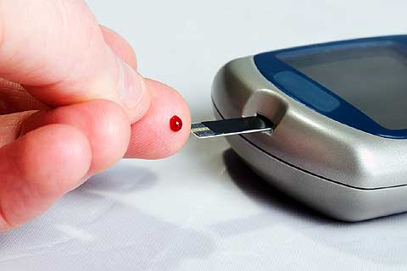

Slide 124
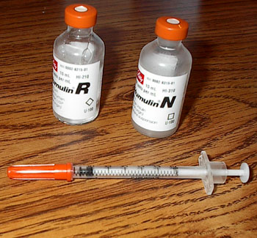

Slide 125
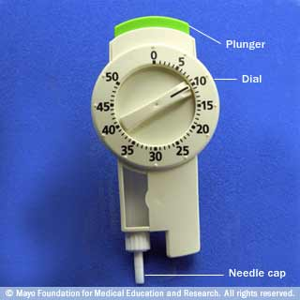
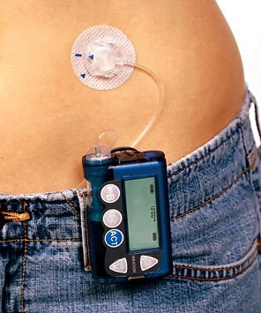

Slide 127
Conclusion

Slide 128
Take home messages
Care systems should support team-based care, community involvement, patient registries and embedded decision support tools to meet patient needs
Treatment decisions should be timely, based on evidence-based guidelines tailored to individual patient preferences, prognoses, and co-morbidities
A patient-centered communication style should be employed that incorporates patient preferences, assesses literacy and numeracy, and addresses cultural barriers to care

Slide 129
Thank You!!

